Slide 1
Thank you for volunteering
for the 2023 FOS Campaign

Slide 2
Friends of Scouting Structure
Seneca Waterways FOS Campaign
Leadership
District Campaigns
Board Members
Friends of the Board
Council Staff
Family
Community

Slide 3
Friends of Scouting Investments
Recruitment
Training & Resources for Adult Volunteers
Council Service Center
Professional and support Staff
Volunteer Coaching
Strategic Planning
Council Website
Two Outstanding Camps
Staff
Operating Costs
Insurance
Record Keeping
Liability Insurance Coverage
Volunteer Recruitment Support
Unit Program Planning

Slide 4
2023 District FOS Goal - $145,000
District | Leadership | Community | Family | Totals
Erie Trails | $14,000 | $7,000 | $19,000 | $40,000
Exploring | $1,000 | $500 | $500 | $2,000
Glacier Lakes | $3,500 | $5,000 | $13,500 | $22,000
High Falls | $5,000 | $3,000 | $10,000 | $18,000
Turning Point | $1,000 | $3,500 | $500 | $5,000
Waters Edge | $5,000 | $10,000 | $15,000 | $30,000
Western Gateway | $6,000 | $2,500 | $19,500 | $28,000

Slide 5
Why Do People Give??
Someone I know asked me to give
I felt emotionally moved by someone’s story
I want to feel that I’m changing someone’s life
I feel a sense of attachment to a group or community
I need a tax deduction
I want to memorialize someone

Slide 6
The Process
Days Out | Action | Responsible
-14 | Unit Coordinator & Presenter Intro/Goal Email | District
-7 | Unit Coordinator sends out pre-presentation Email | Unit Coordinator
0 | Presentation Day | Unit Coordinator/ Presenter
0-1 | Report your presentation results to District Executive | Presenter
+1-2 | Return kit to SWC | Presenter
+5 | Post-presentation Thank You Email to entire unit | Unit Coordinator
+7 | Status to goal update | District
+15 | 30 days to goal Email | District
? | Platinum Unit Congratulations Email | Council

Slide 7
Prior to Presentation
Contact the unit coordinator to identify what’s important to them
Camping? Service?
What events have they participated in?
Confirm location, time and details
Confirm how much time you’ll have to speak
Ask to be introduced by a Unit Leader who can make a lead gift at the presentation

Slide 8
Day of Presentation
Arrive 15 minutes early, in full uniform
Confirm Unit Leader will make positive introduction
Make presentation early in program
Hand out pledge forms in advance
Set expectation for all forms to be returned
Reinforce unit goal and Platinum benefits
Collect completed pledge forms (legibility!)
Have a “plant.”
Report back to the unit with total gifts
If possible, plan on staying for the whole event
Report that night’s results to District professional by text or email within 24 hours

Slide 9
Presentation Logistics
Remember that you are making this presentation to provide everyone with the opportunity to fully participate in the Scouting program.
Most people aren’t aware their annual dues (including BSA membership fee) goes to National office and/or unit, and that Seneca Waterways receives little or no benefit
Council invests $216+ per Scout in programs/services.
Have pledge cards and recognition items with you as you speak for reference.
Body of your presentation needs to be from the heart.

Slide 10
FOS Presentation Recipe
Step 1: The Introduction
Ask the Unit Leader to give a public lead gift.
Introduce yourself as a volunteer or parent of x number of Scouts.
Thank the parents and volunteers for participating in Scouting.
Step 2: What is Friends of Scouting
Once a year opportunity to support the Seneca Waterways Council. SWC invests $216 per Scout annually for over 6,000 youth in our communities.
In lieu of a Council registration fee, we rely on generosity of our community via FOS campaign.
Friends of Scouting campaign represents over 25% of direct support, and allows us to keep Scouting local and accessible.
Step 3: What does the Scouting Provide
Tell your story
Memories at our council camps and events. Talk about what the unit participates in.
Introduce one or more examples of FOS investment (subsidizes three outstanding camps, adult and youth training, financial assistance, etc)
Step 4: The Ask
“Your gift helps create better young people, and is an investment in the next generation. Consider a gift of $216 ($18/month) to help support Scouting in the Seneca Waterways Council. If you can give more, that’s appreciated. Any contribution you can make to help support our mission is greatly appreciated.”

Slide 11
Steps for Success
Sign up early and hold presentation before May 15
Conduct presentation in 1st half of the unit meeting
Recruit 2-3 Scouts to hand out pens and collect pledge forms
Have a dedicated FOS Unit Coordinator that will:
Email all unit families 1-2 weeks in advance
Introduce the presenter at the unit event
Ensure a Unit Leader gives a lead gift
Follow up after the presentation
Update the goal after the presentation. Hand out gift to whomever guessed closest to the total.

Slide 12
Presentation Kit
Friend of Scouting 2023 Unit Ribbon
Friend of Scouting Pledge Forms
Pens
Mug
Empty Return Envelope
Recognition Items
Participation Window Decals (gifts $1+)
Friend of Scouting “On my Honor” Patches (gift => $216)
Iceberg Analogy (The True Cost of Scouting sheet)
Unit Family FOS Report form

Slide 13
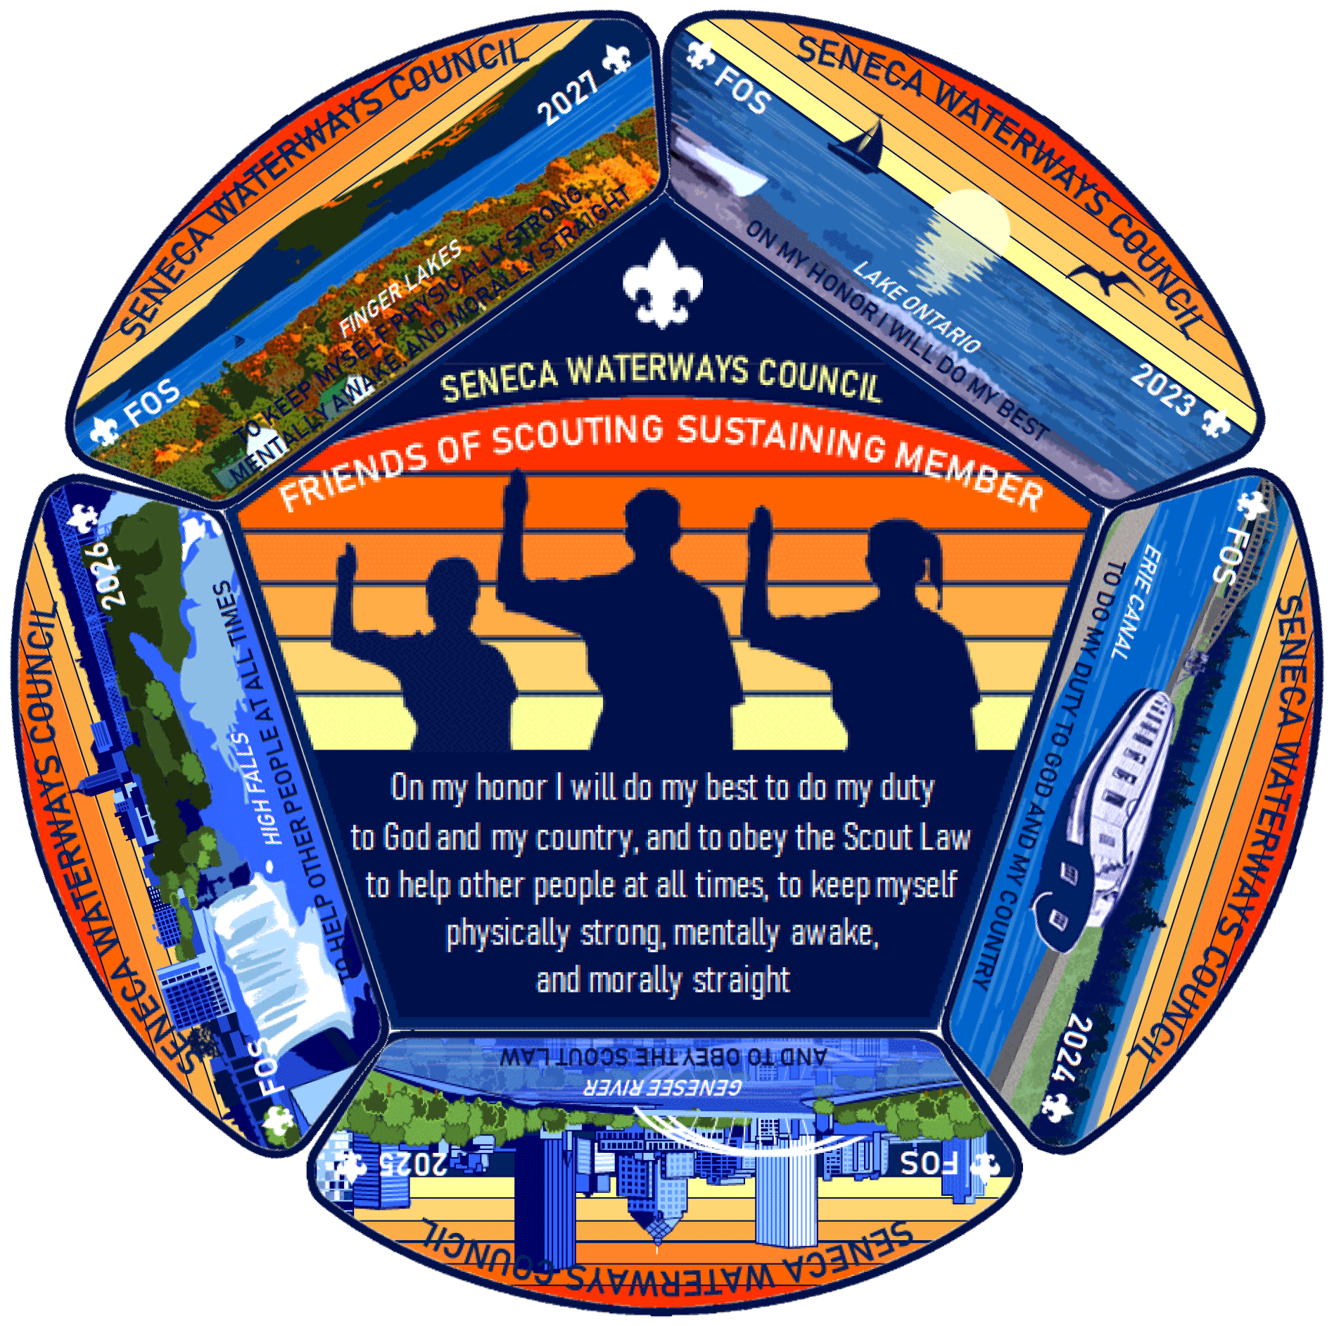
Donor Recognition Levels
Gift Level | Thank You Items
$0 | Pen
$1+ | Friend of Scouting Window Cling Decal
>$216 | On My Honor Shoulder Patch (fully embroidered)
Multi-Year Commitments of $250+ | Full Set of Patches

Slide 14
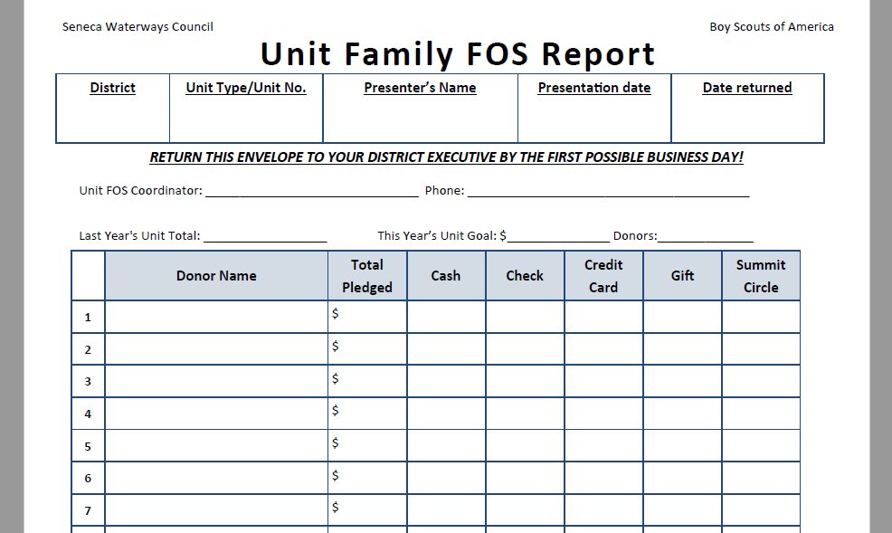
After the Presentation

Slide 15
Unit Goals – Platinum Recognition
This is our Friends of Scouting campaign
Units with 50% of families making a pledge and an average gift of $108 earn Platinum Status.
Free cloth rank advancement
BOGO cabin rental at Massawepie or Cutler
Recognition runs one year from month earned.
The average 20-Scout unit can earn $145+ in savings.

Slide 16
Credit Card Donations
Credit Card donations can be made in two ways:
During presentation by completing the pledge form
One-time donation
Recurring Gift (Summit Circle)
Anytime at www.senecawaterways.org/give
Donor must type in District and Unit # to ensure gift is credited to the unit

Slide 17
Matching Gifts
Remind everyone that many employers offer matching gift programs to encourage employees to donate
Complete EMPLOYER line on pledge form
Multiply the impact of their contribution
Your Gift $$ Your Impact $$$$
Visit www.senecawaterways.org/matchmygift
Search engine to identify company match

Slide 18
THANK YOU!

